Slide 1
Human-Robot Interaction:
Attention System 2
by Dr. Katrin S. Lohan
*Multiple slides over the course adapted form Alessandra Sciutti @Italien Institute of Technology

Slide 2
Attention
Attention is the behavioural and cognitive process of selectively concentrating on a discrete aspect of information, whether deemed subjective or objective, while ignoring other perceivable information.
Attention has also been referred to as the allocation of limited processing resources.

Slide 3
Attention
Visual Attention
Audio Attention
Joint Attention
Turn Taking

Slide 4
Visual Attention
In robotics visual attention needs to use a light weight methods
mimic the bottom-up process of human attention through saliency mechanism
anticipatory gaze a first step towards top-down process of an attention system

Slide 5
Multiscale Visual Saliency
Image Pyramids : http://docs.opencv.org/2.4/doc/tutorials/imgproc/pyramids/pyramids.html
Linear Filters: http://docs.opencv.org/2.4/doc/tutorials/imgproc/imgtrans/filter_2d/filter_2d.html#filter-2d
Orientation detection with Sobel Derivatives: http://docs.opencv.org/2.4/doc/tutorials/imgproc/imgtrans/sobel_derivatives/sobel_derivatives.html#sobel-derivatives

Slide 6
Multiscale Visual Saliency
Colors/intentsity e.g.: http://docs.opencv.org/2.4/doc/tutorials/imgproc/threshold/threshold.html#basic-threshold
More filters: http://docs.opencv.org/2.4/doc/tutorials/imgproc/imgtrans/hough_circle/hough_circle.html#hough-circle

Slide 7

Audio Attention
Selective auditory attention
The cocktail party effect [1]:
The sounds and noise in the surrounding environment is heard by the auditory system but certain parts of the auditory information are processed in the brain only.
Sound localisation:
ability to identify the location or origin of a detected sound in direction and distance
http://youtu.be/JJoPLrqdzSc

Slide 8
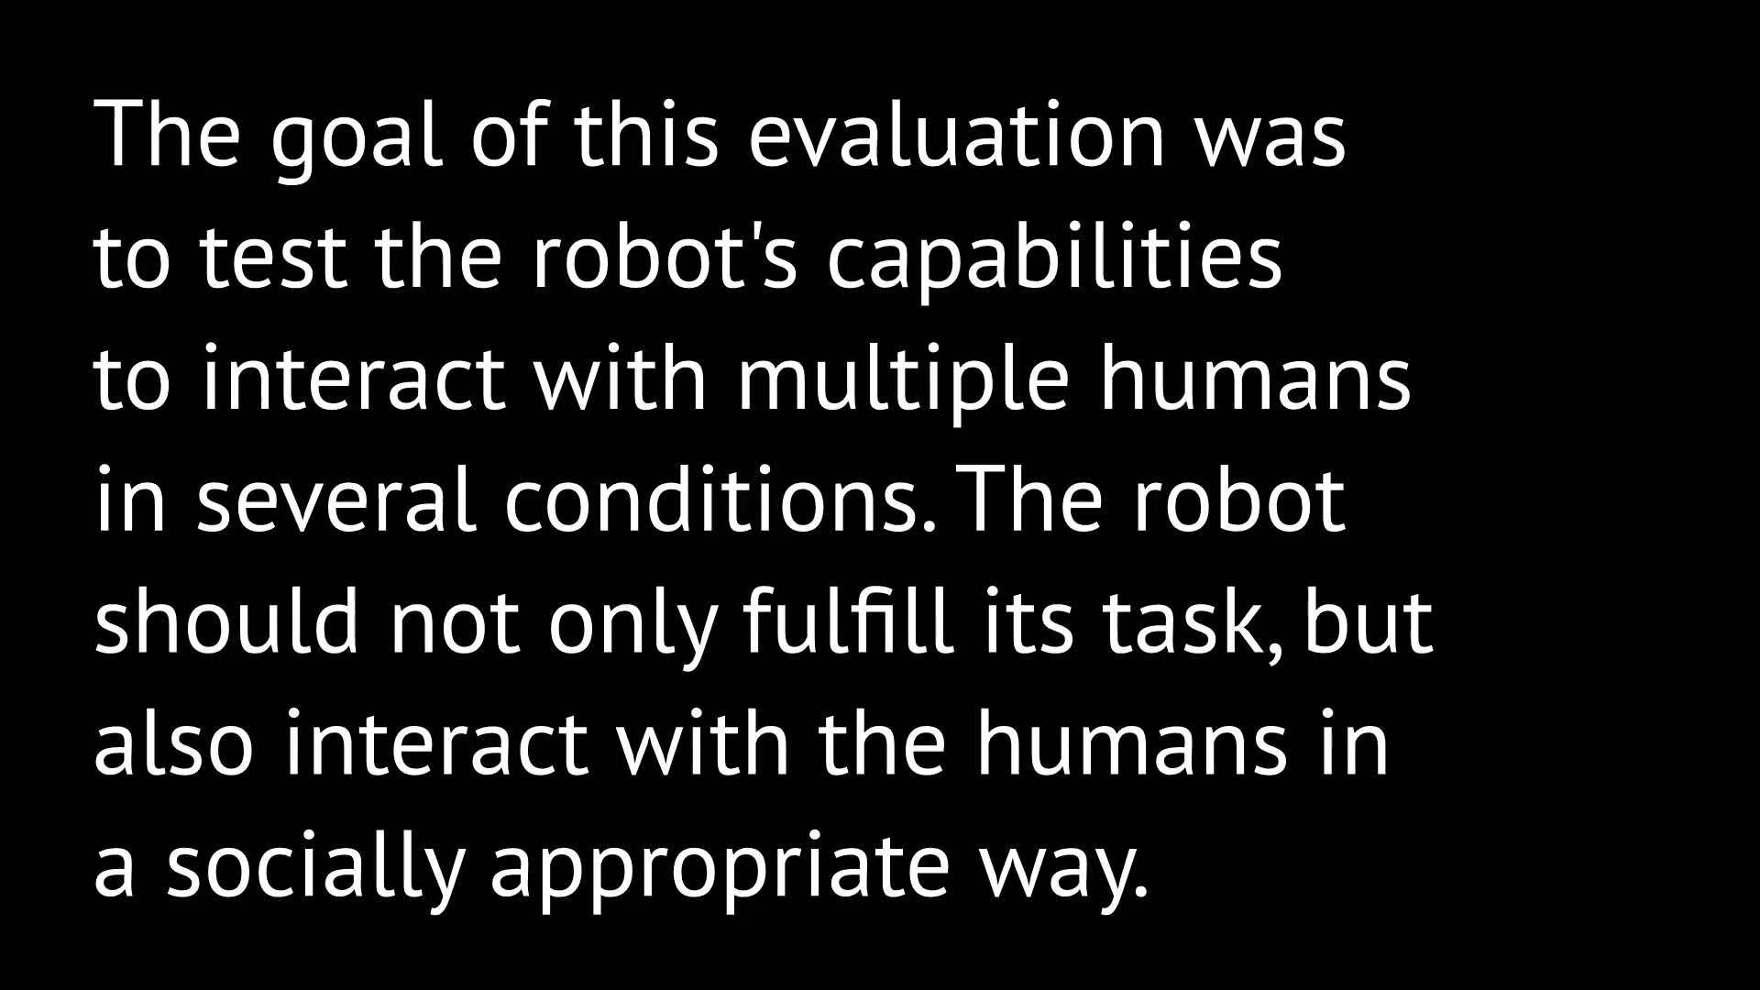
Audio Attention

Slide 9
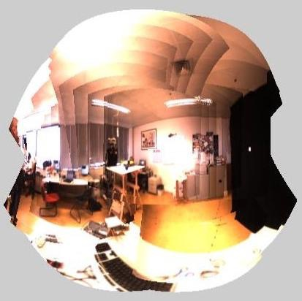
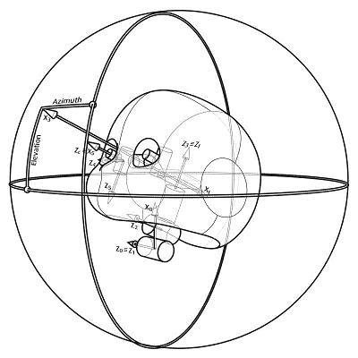
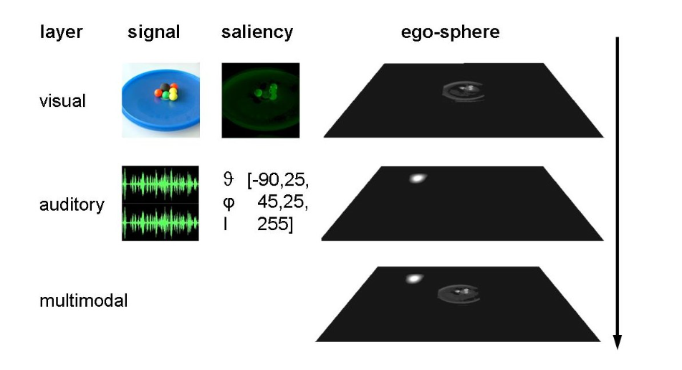
Attention System of the iCub robot
[2]

Slide 10
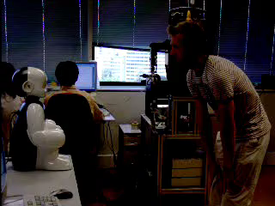
Attention System of the iCub robot

Slide 11
Joint Attention
Joint attention is the shared focus of two individuals on an object
In human robot interaction joint attention is important to create and sustain the interaction [3]

Slide 12
Levels of Joint Attention
We can define different three levels of joint attention:
triadic, dyadic, and shared gaze.
Triadic joint attention: involves two individuals looking at an object
Dyadic joint attention: is a conversation-like behaviour, e.g. adults and infants take turns
Shared gaze: two individuals are looking at the same object

Slide 13

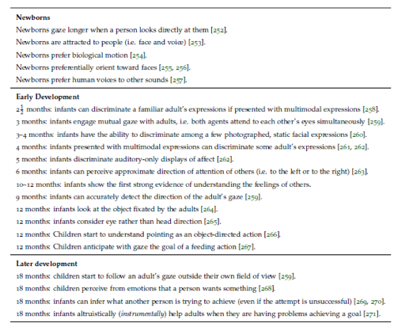
Development of Interaction
(Table by A. Sciutti in D. Vernon “Artificial Cognitive Systems – a primer”, MIT Press)

Slide 14
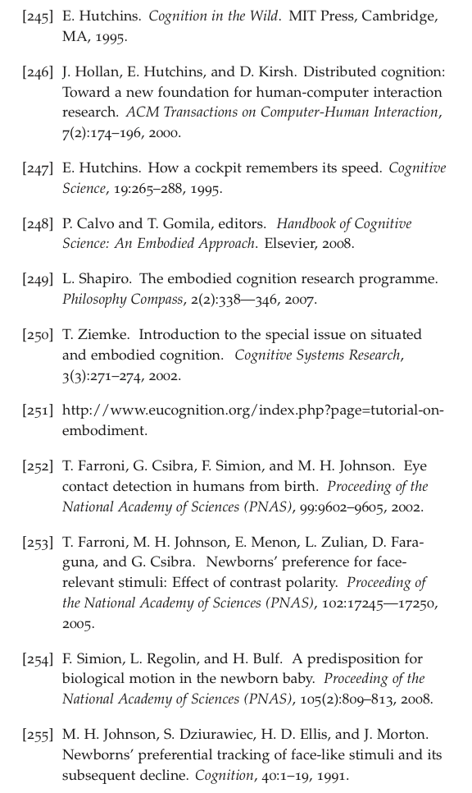
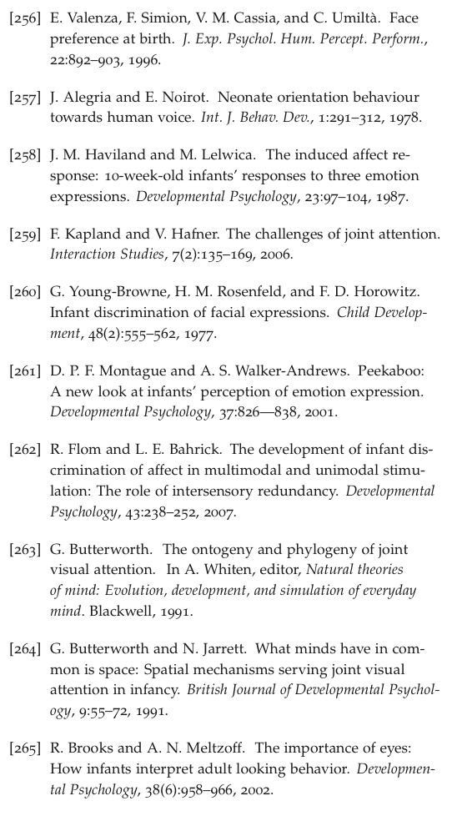
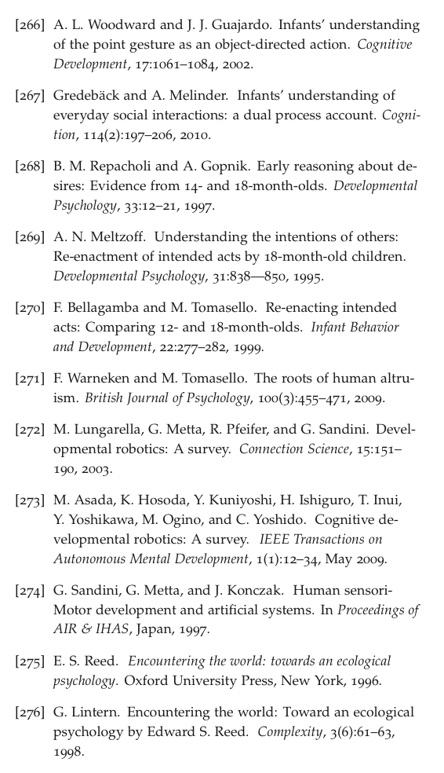
References

Slide 15
Turn Taking
refers to the process by which people in a conversation decide who is to speak next
is a part of the structure and systematic organisation of conversation
gazing behaviour plays a important role in turn-taking mechanisms:
mutual-break: is when there is a pause in the conversation and both participants use a momentary break with mutual gaze toward each other and then breaking the gaze, then continuing conversation again
mutual-hold: is when the speaker also takes a pause in the conversation with mutual gaze, but then still holds the gaze as he/she starts to speak again

Slide 16
Why Attention Systems?
Visual Attention:
Bio inspired bottom up processes
“Cognitive” Top down (e.g. Mirror Neurons system)
Audio Attention
mostly bio inspired bottom up processes (e.g. Selective auditory attention)
Joint Attention
to create interaction capabilities for robots
e.g. Turn Taking

Slide 17
Discussion on HRI
Why?
What are the obstacles to overcome ?
How can we benefit from it?
Why do we take us (humans) as an example?
What ethical implications does HRI has for the society?

Slide 18
References
[1] Wood, N., & Cowan, N. (1995). The cocktail party phenomenon revisited: how frequent are attention shifts to one's name in an irrelevant auditory channel?. Journal of Experimental Psychology: Learning, Memory, and Cognition, 21(1), 255.
[2] Ruesch, J., Lopes, M., Bernardino, A., Hornstein, J., Santos-Victor, J., & Pfeifer, R. (2008, May). Multimodal saliency-based bottom-up attention a framework for the humanoid robot icub. In Robotics and Automation, 2008. ICRA 2008. IEEE International Conference on (pp. 962-967). IEEE.
[3] Lohan, K. S., Rohlfing, K. J., Pitsch, K., Saunders, J., Lehmann, H., Nehaniv, C. L., ... & Wrede, B. (2012). Tutor spotter: Proposing a feature set and evaluating it in a robotic system. International Journal of Social Robotics, 4(2), 131-146.

